Slide 1
IPHIS: IMMUTABLE PERSONAL HEALTH INFORMATION SYSTEM BIOMETRIC AUTHENTICATION
Presented By: Rajesh B. Chavan
Created Date: 1-08-2018
Sponsored By: ReyGlobal, India.

Slide 2
What is Biometric Authentication?
Biometric authentication is simply the process of verifying your identity using your measurements or other unique characteristics of your body, then logging you in a service, an app, a device and so on.
Biometric identification verifies you are you based on your body measurements.
Biometric authentication goes one step further and uses that information to compare you against a database and enters your information in a service.

Slide 3
Fingerprint Sensor
A Fingerprint Sensor is a electronic device used to capture a digital image of fingerprint pattern.
The captured image is called live scan. This live scan is digitally processed to create a biometric template(a collection of extracted features) which is stored and used.

Slide 4
What is an SDK?
A software developer's kit (SDK) is a set of programs used by a computer programmer to write application programs.
Typically, an SDK includes a visual screen builder, an editor, a compiler, a linker, and sometimes other facilities.
Fingerprint Verification software development kit is a SDK designed for adding fingerprint verification functionality into various applications.

Slide 5
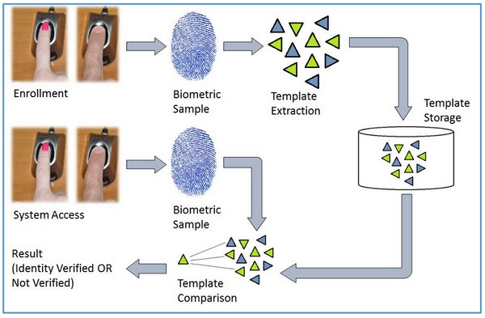
How it works?

Slide 6
Biometrics Terminology
Biometric Template − It is a digital reference of the distinct characteristics that are extracted from a biometric sample.
Candidate/Subject − A person who enters his biometric sample.
Closed-Set Identification − The person is known to be existing in the database.
Enrollment − It is when a candidate uses a biometric system for the first time, it records the basic information such as name, address, etc. and then records the candidate’s biometric trait.

Slide 7
False Acceptance Rate (FAR) − It is the measure of possibility that a biometric system will incorrectly identify an unauthorized user as a valid user.
FAR = Number of False Acceptances
Number of Identification Attempts
A biometric system providing low FAR ensures high security.
False Reject Rate (FRR) − It is the measure of possibility that the biometric system will incorrectly reject an authorized user as an invalid user.
FRR = Number of False Rejections
Number of Identification Attempts
Open-Set Identification − The person is not guaranteed to be existing in the database.
Task − It is when the biometric system searches the database for matching sample.

Slide 8
VeriFinger SDK
The VeriFinger SDK allows to develop a wide range of biometric applications that identify fingerprints taken from fingerprint scanner or image files against fingerprints stored in a database.
Also, the VeriFinger SDK does not have any limitations on fingerprint database size and allows to develop both standalone PC-based and Web-based application that use client-server architecture.
VeriFinger SDK includes the Device Manager library for working with the supported fingerprint readers.
VeriFinger SDK includes biometric components for fingerprint image capture and segmentation, fingerprint template extraction and matching, as well as biometric standards and specific image format support.

Slide 9
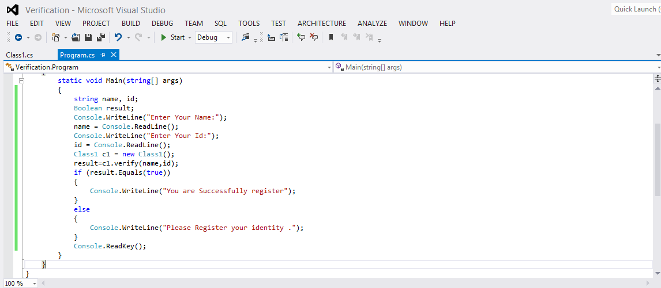
Application:

Slide 10
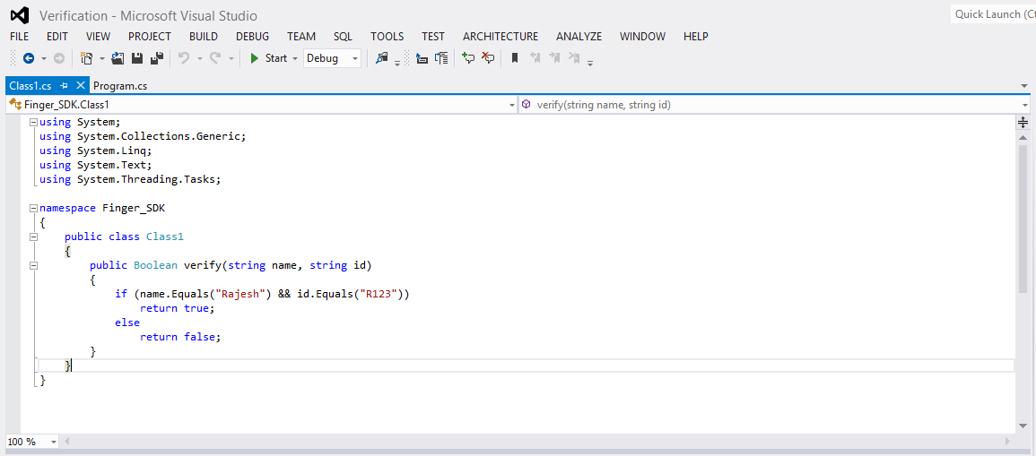
DLL File:

Slide 11
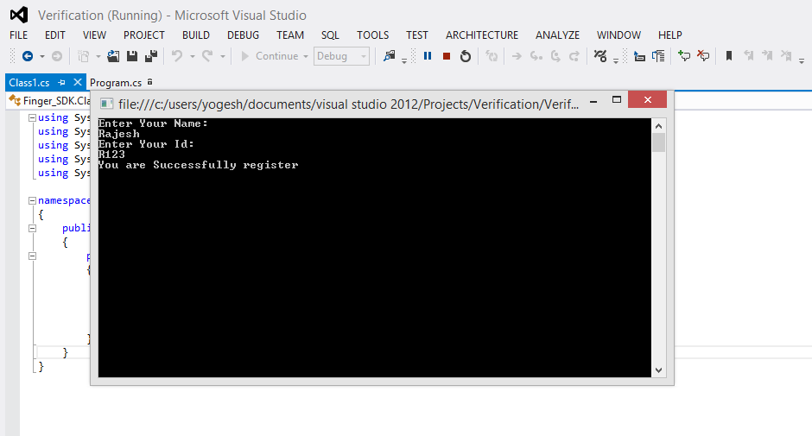
Output:

Slide 12
Steps for using SDK:
First create the DLL file.
In main application import the namespace in which the DLL file is present.
In application add the reference of DLL file.
Then access the method using object of class present in DLL file.
The same steps we can use to include SDK to our application.

